Slide 1

COMS W4111 - Introduction to Databases
Continue and Complete NoSQL DBs; Normalization/De-Normalization; Data Analysis
Donald F. Ferguson (dff@cs.columbia.edu)
Lecture 13: No SQL, Normalization

Slide 2

Contents
2 | Introduction to Databases (F18): Lecture 13 -- No SQL, Normalization

Slide 3
Contents
A Diversion: ORM, persistence/mapping frameworks.
Graph Database Completion – Some simple examples:
Neo4J and HW4
Facebook.
Redis:
Overview.
API
DynamoDB: really short overview
Putting the pieces together: SQL and NoSQL example.
Relational Normalization/De-normalization.
Setup for HW5

Slide 4
A Diversion: ORM, persistence /mapping frameworks
4 | Introduction to Databases (F18): Lecture 13 -- No SQL, Normalization

Slide 5
Piazza Discussion
Piazza thread https://piazza.com/class/jkb0pv2a65m35?cid=887
Created quite a debate.
Included questioning my fairness and competency, as well as the integrity and work ethic of fellow students.
Made it clear that a non-traditional approach to running courses alienates a significant portion of students and does not meet there needs.
There will be changes in my section of W4111. Most of these will occur starting 2019, but we still have time to make changes for fall 2018.
Office hours will be 9:00 to 10:00 AM on Friday, or by appointment. No additional OH or recitations.
I will disable anonymous posting on Piazza. Any questions or discussion that I consider collaborating on a solution will result in failing the course.
Final exam will be in class at the Registrar assigned time and will be closed book. No exceptions or extensions.

Slide 6
Piazza Discussion
Piazza thread https://piazza.com/class/jkb0pv2a65m35?cid=887
Created quite a debate.
Included questioning my fairness and competency, as well as the integrity and work ethic of fellow students.
Made it clear that a non-traditional approach to running courses alienates a significant portion of students and does not meet there needs.
There will be changes in my section of W4111. Most of these will occur starting 2019, but we still have time to make changes for fall 2018.
Office hours will be 9:00 to 10:00 AM on Friday, or by appointment. No additional OH or recitations.
I will disable anonymous posting on Piazza. Any questions or discussion that I consider collaborating on a solution will result in failing the course.
Final exam will be in class at the Registrar assigned time and will be closed book. No exceptions or extensions.
I am not going to do any of these things:
I put a tremendous amount of thought into how I run the course.
My plans and decisions are my belief of the best way to educate and prepare the students.
Some advice:
Speak to people one-on-one about concerns. Do not start a public spat.
When you say something to someone, focus on:
Leading them to an outcome you want.
Not on something that temporarily makes you feel better.

Slide 7
Piazza Discussion
7 | Introduction to Databases (F18): Lecture 13 -- No SQL, Normalization

Slide 8
Object “Relational” Mapping
Object-relational mapping (ORM, O/RM, and O/R mapping tool) in computer science is a programming technique for converting data between incompatible type systems using object-oriented programming languages. This creates, in effect, a "virtual object database" that can be used from within the programming language. There are both free and commercial packages available that perform object-relational mapping, although some programmers opt to construct their own ORM tools.
In object-oriented programming, data-management tasks act on objects that are almost always non-scalar values. For example, an address book entry that represents a single person along with zero or more phone numbers and zero or more addresses. This could be modeled in an object-oriented implementation by a "Person object" with attributes/fields to hold each data item that the entry comprises: the person's name, a list of phone numbers, and a list of addresses. The list of phone numbers would itself contain "PhoneNumber objects" and so on. The address-book entry is treated as a single object by the programming language (it can be referenced by a single variable containing a pointer to the object, for instance). Various methods can be associated with the object, such as a method to return the preferred phone number, the home address, and so on.
However, many popular database products such as SQL database management systems (DBMS) can only store and manipulate scalar values such as integers and strings organized within tables. The programmer must either convert the object values into groups of simpler values for storage in the database (and convert them back upon retrieval), or only use simple scalar values within the program. Object-relational mapping implements the first approach.^{[1]}
The heart of the problem involves translating the logical representation of the objects into an atomized form that is capable of being stored in the database while preserving the properties of the objects and their relationships so that they can be reloaded as objects when needed. If this storage and retrieval functionality is implemented, the objects are said to be persistent.

Slide 9
Simplistic Overview
ClientServer
Application Code
Framework (Mapping)
Database Server
Database
Network
Language Driver
Language Driver
Database Driver
Network Driver

Slide 10
Simplistic Overview
ClientServer
The application code is what you write to implement your homework (project)
Network driver is part of the operating system and sends/receives message using HTTP, TCP/IP, etc.
Database driver uses network driver to send commands and receive response, e.g.
SELECT * FROM …
Match (n:Node) return …
The commands and responses are in string/byte format.
The language driver connects to database driver to language concepts in a library, e.g. functions, object.
Framework/Mapping “reduces” the mismatch between
Language model.
Database model.
Application Code
Framework (Mapping)
Database Server
Database
Network
Language Driver
Language Driver
Database Driver
Network Driver

Slide 11
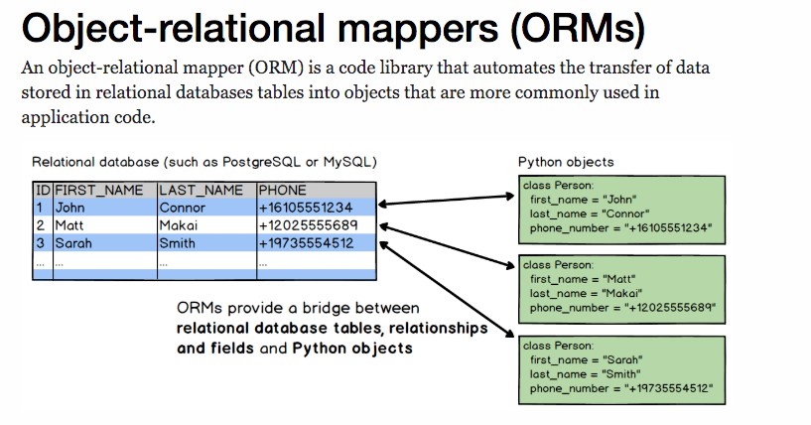
Object “Relational” Mapping – Simple Python Example
https://www.fullstackpython.com/object-relational-mappers-orms.html

Slide 12
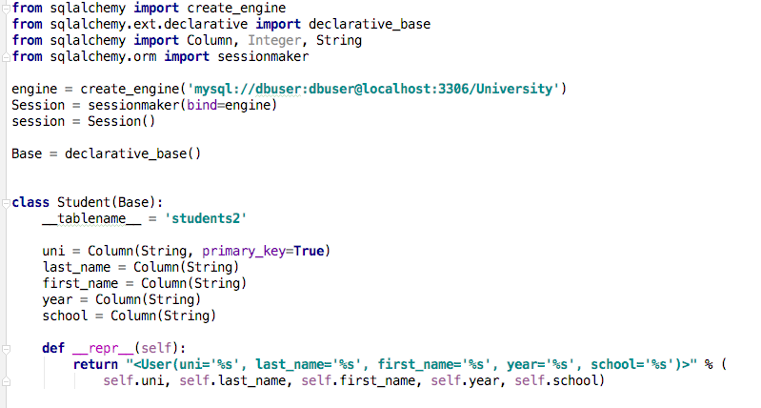
Object “Relational” Mapping – Simple Python Example

Slide 13
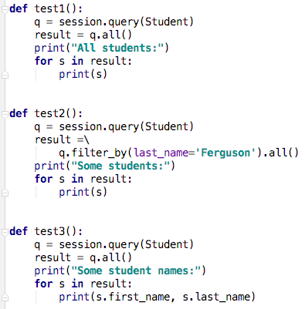
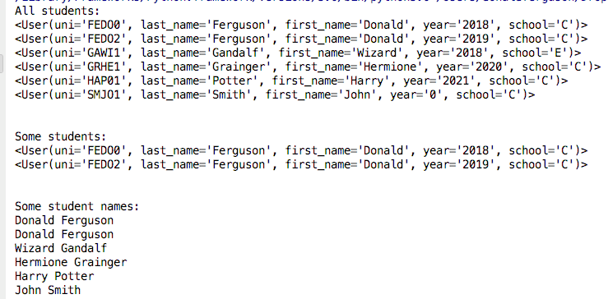
Object “Relational” Mapping – Simple Python Example

Slide 14
Java Hibernate

Slide 15
Some Questions
Why did I take this diversion?
I have alluded to various frameworks, but never covered. You should be aware of the option of using the frameworks.
py2neo is an example of one of these frameworks.
There are pros and cons to using the frameworks:
Pros: significantly improved productivity for simple applications and mappings.
Cons: Anything complex can be virtually impossible if you use a framework.
The Wikipedia article is a good start on pros and cons.
Why didn’t I tell you about/let you use these frameworks?
You would not have learned the fundamental concepts in databases and models.
Frameworks are not helpful for many application scenarios.

Slide 16
Graph Database Completion
16 | Introduction to Databases (F18): Lecture 13 -- No SQL, Normalization

Slide 17

Neo4j and HW4
17 | Introduction to Databases (F18): Lecture 13 -- NoSQL, Normalization

Slide 18
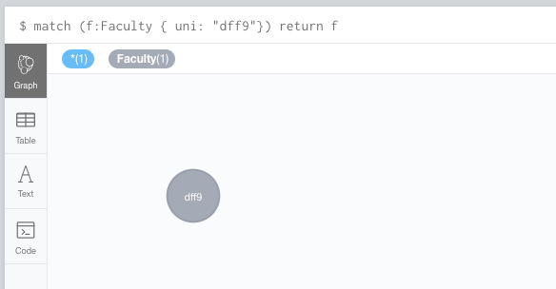
A Simple Neo4j Query

Slide 19
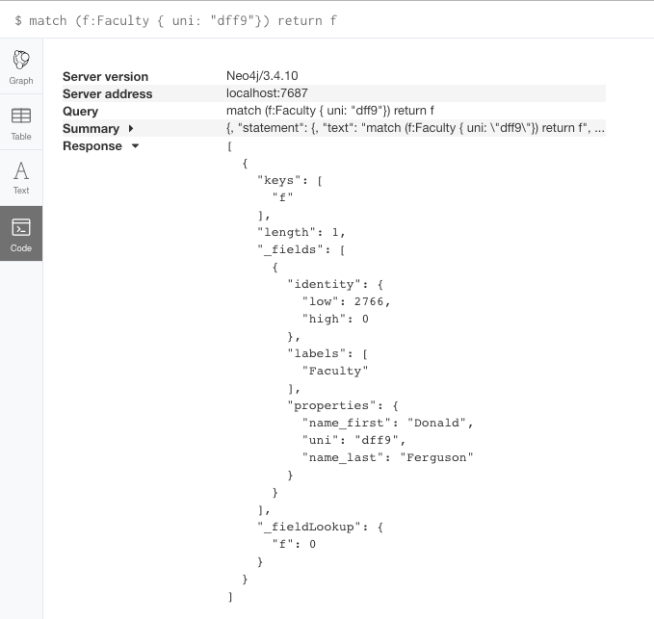
A Simple Neo4j Query
What is really happening?
The query is returning a complex data structure.
Code running in JavaScript in the browser is
Parsing response.
Laying out the graph.
When
You directly use a language driver/connector.
You get a similarly complex data structure.
Mapping into the language constructs.

Slide 20
Using a driver
import json from HW4Template.utils import utils as ut from neo4j.v1 import GraphDatabase ut.set_debug_mode(False) _driver = GraphDatabase.driver(uri="bolt://localhost:7687", auth=("neo4j", ”XXXXXXX")) def close(self): self._driver.close()

Slide 21
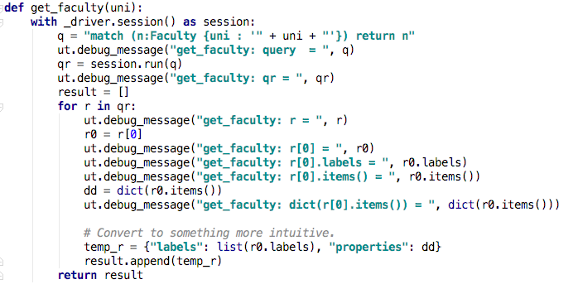
Using a driver

Slide 22
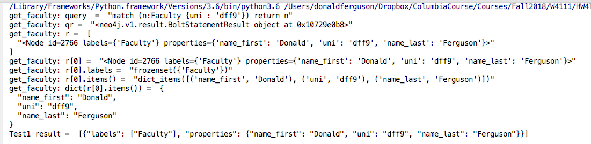
Using a driver
Relational database queries operate on tables and produce tables.
Neo4j queries operate on graphs and (usually) product graphs.
Programming languages do not directly support tables or graphs.
So, the drivers convert the query results into the programming languages types and constructs:
cursor() and list[] or OrderedDict{} for relational and Python.
BoltStatementResult for Neo4j and Python

Slide 23
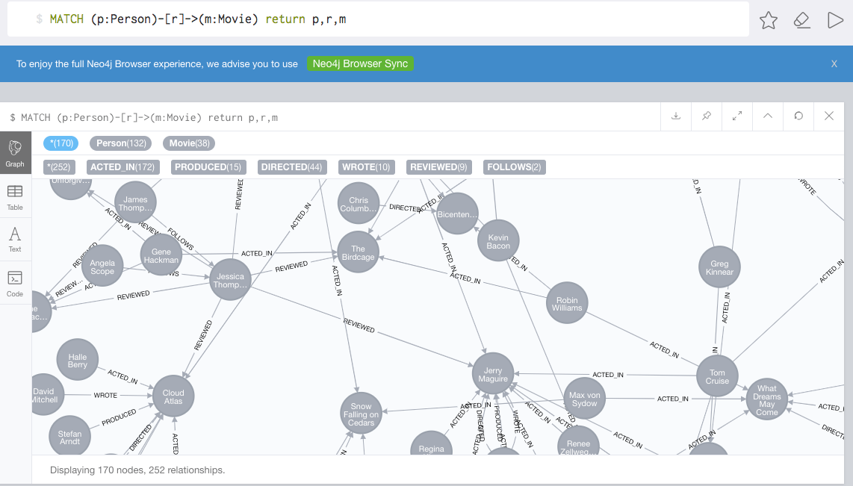
Graphs

Slide 24
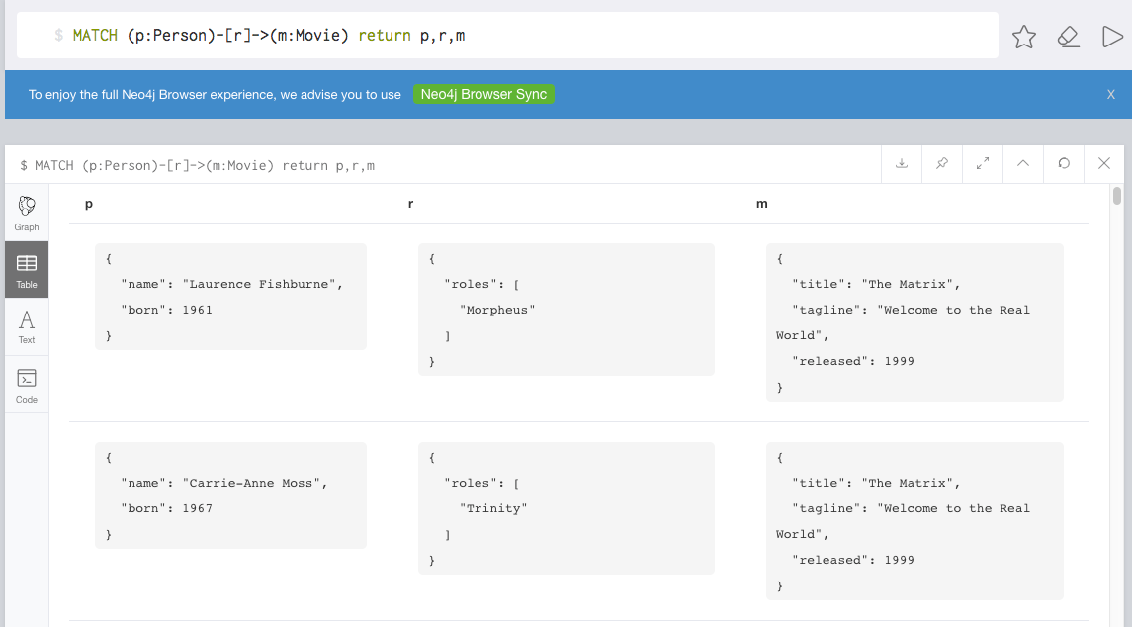
Graphs

Slide 25
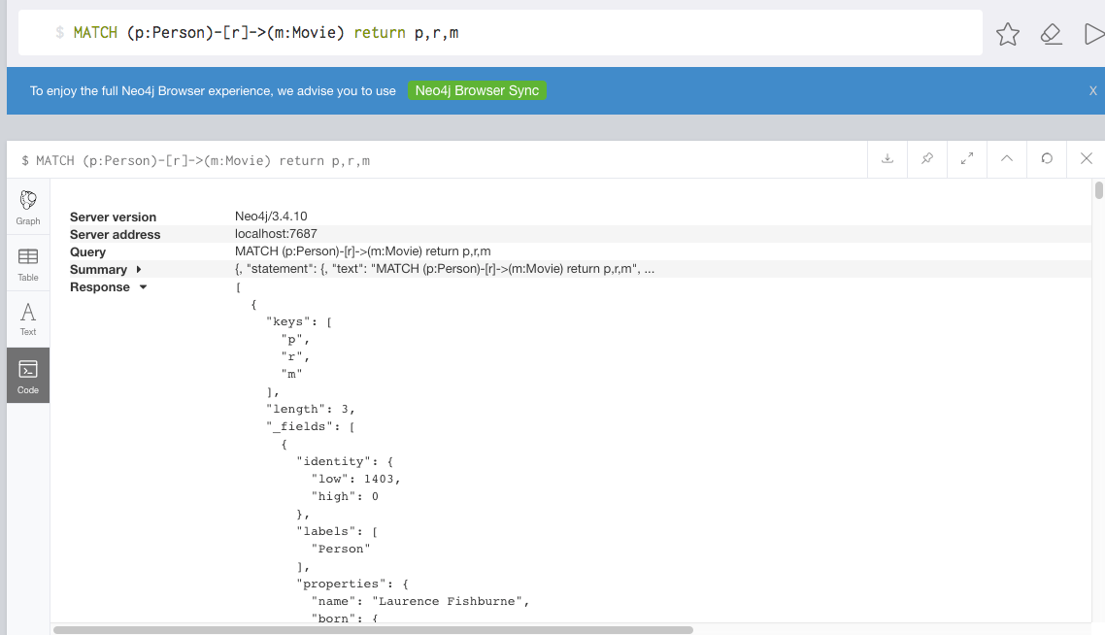
Graphs
This is what is actually coming back to Python.
Gets mapped into a relatively complex but powerful Python data structure.
https://neo4j.com/docs/api/python-driver/current/results.html

Slide 26
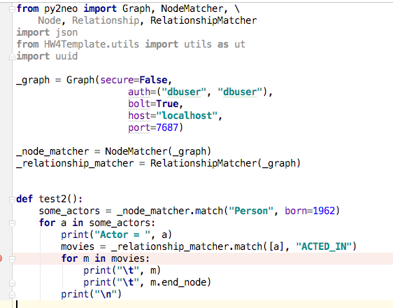
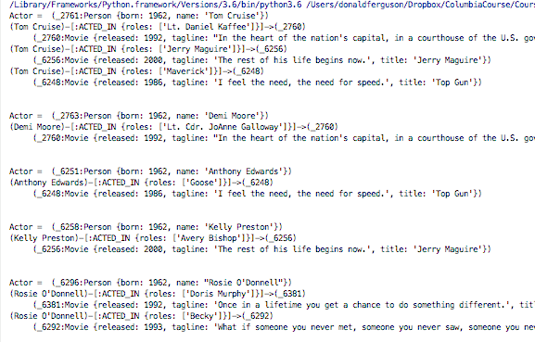
py2neo, queries and HW4

Slide 27
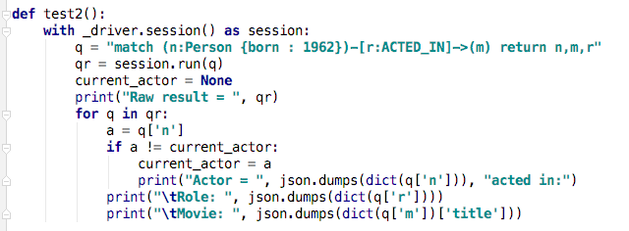
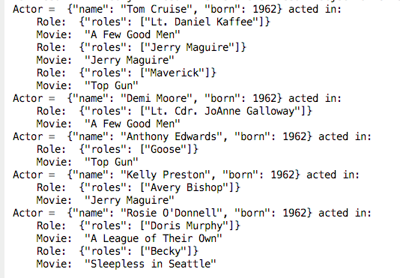
Without py2neo

Slide 28
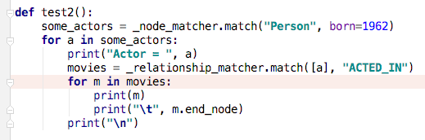
Comparison – Which is Easier?
Direct use of language driver.
py2neo

Slide 29
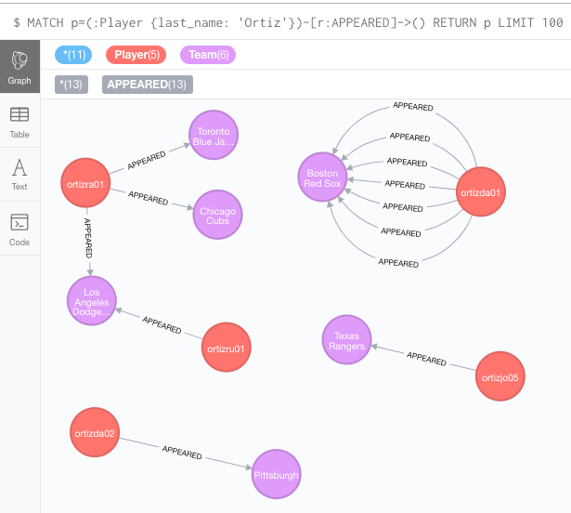
Interesting Query 1
Note: I loaded
All appearances since 2010.
Players that appeared.
Find all of the appearances by a player with last_name ‘Ortiz’
Note 2:
Cannot create multiple relationships with same name using py2neo.
I had to use raw Cypher

Slide 30
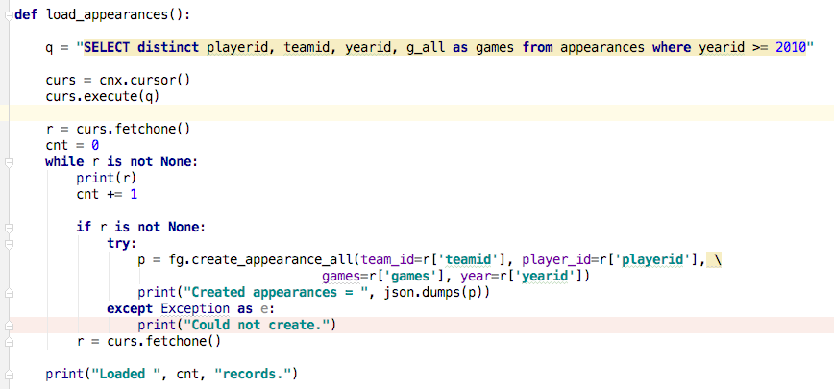
Interesting Query 2 – Loading All Appearances

Slide 31
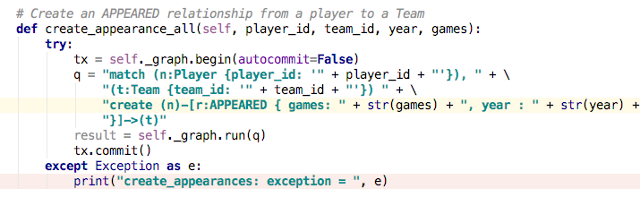
Interesting Query 2 – Loading All Appearances

Slide 32
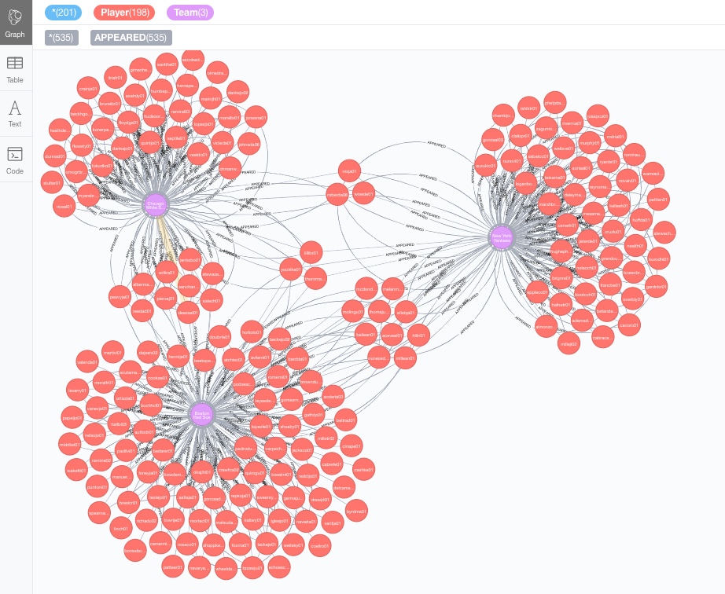
Kevin Youkilis’ Teammates
MATCH c=(p:Player {last_name: 'Youkilis'})
-[r1:APPEARED]->
(t:Team)
<-[r2:APPEARED]-
(p2:Player)
where not p = p2 and r1.year = r2.year RETURN c

Slide 33
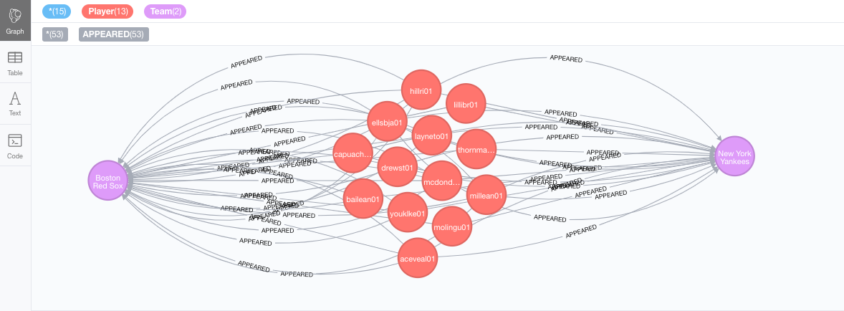
Find Recent Traitors
MATCH (p:Player)-[r1:APPEARED]->(t:Team {team_id: "NYA"}), (p:Player)-[r2:APPEARED]->(t2:Team {team_id: "BOS"}) where r2.year < r1.year return p,r1,t,r2,t2

Slide 34
Facebook Graph API
34 | Introduction to Databases (F18): Lecture 13 -- NoSQL, Normalization

Slide 35
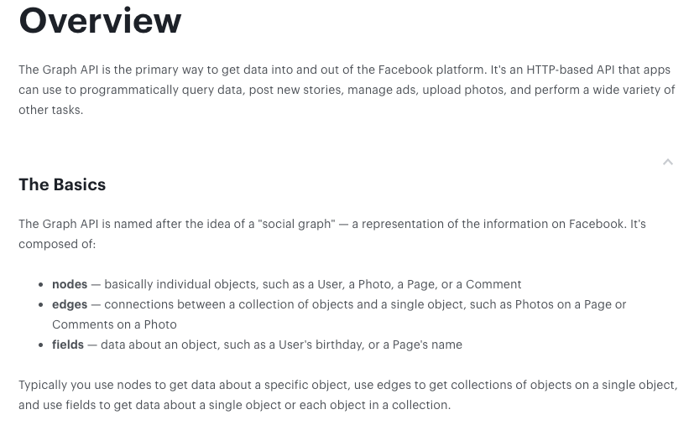
Facebook Graph API
https://developers.facebook.com/docs/graph-api/overview

Slide 36
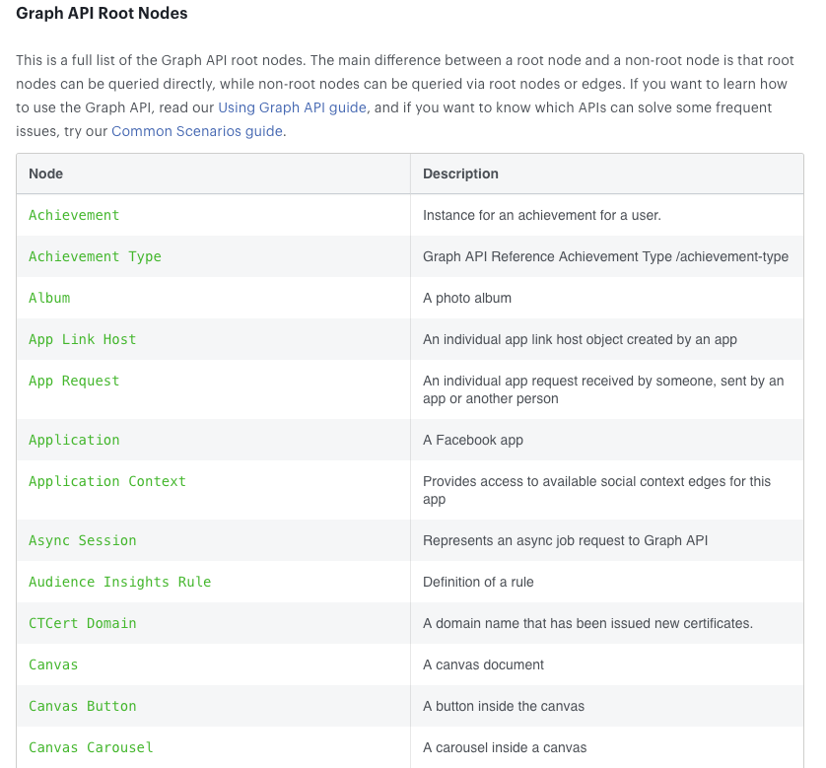
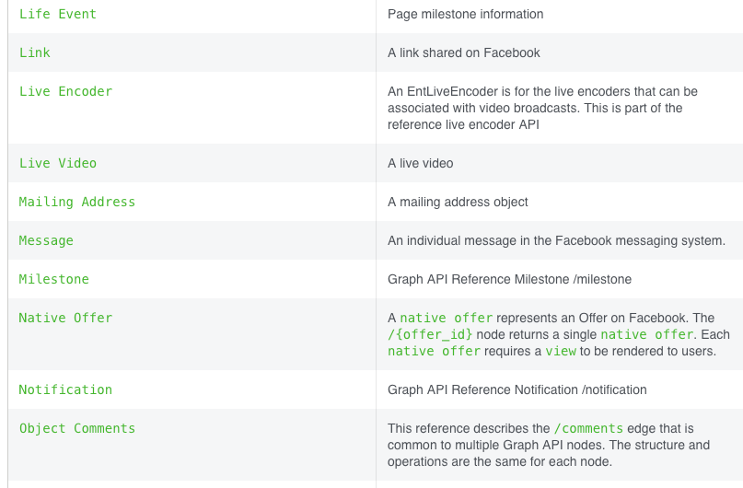
Facebook Graph API
Full list at:
https://developers.facebook.com/docs/graph-api/reference
… … …

Slide 37
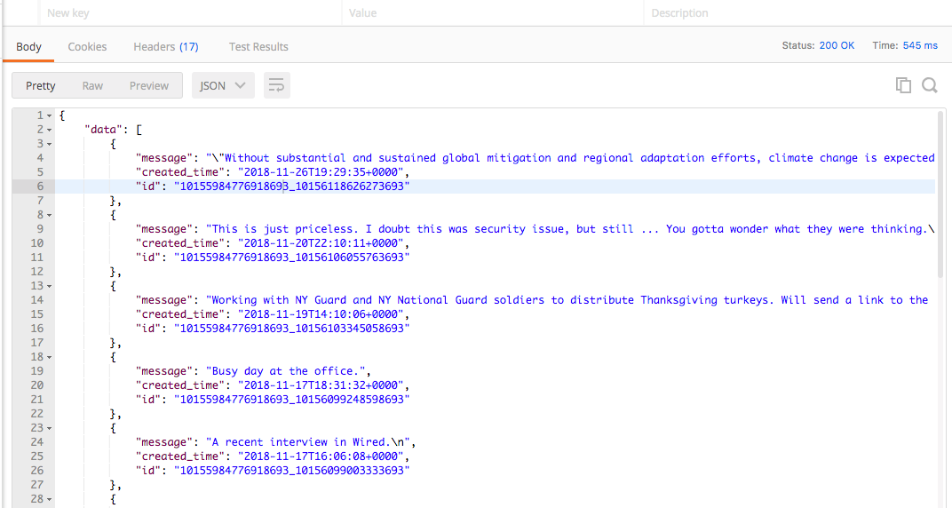
Facebook Graph API – Examples
https://graph.facebook.com/v3.2/me/posts?access_token=xxxxxxx

Slide 38
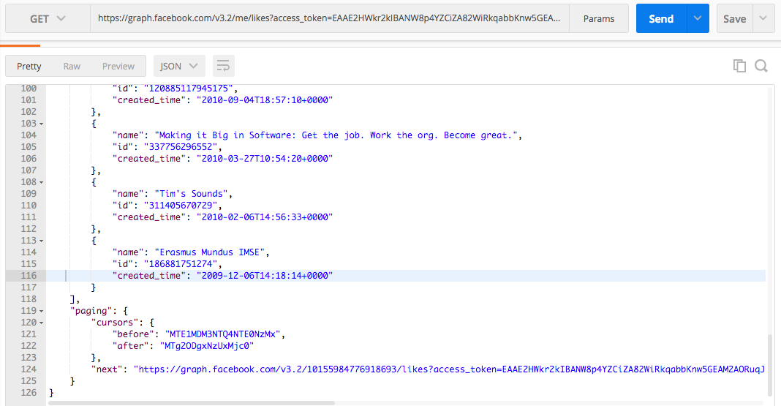
Facebook Graph API – Examples
https://graph.facebook.com/v3.2/me/likes?access_token=xxxxxxx
Notice use of paging links.

Slide 39
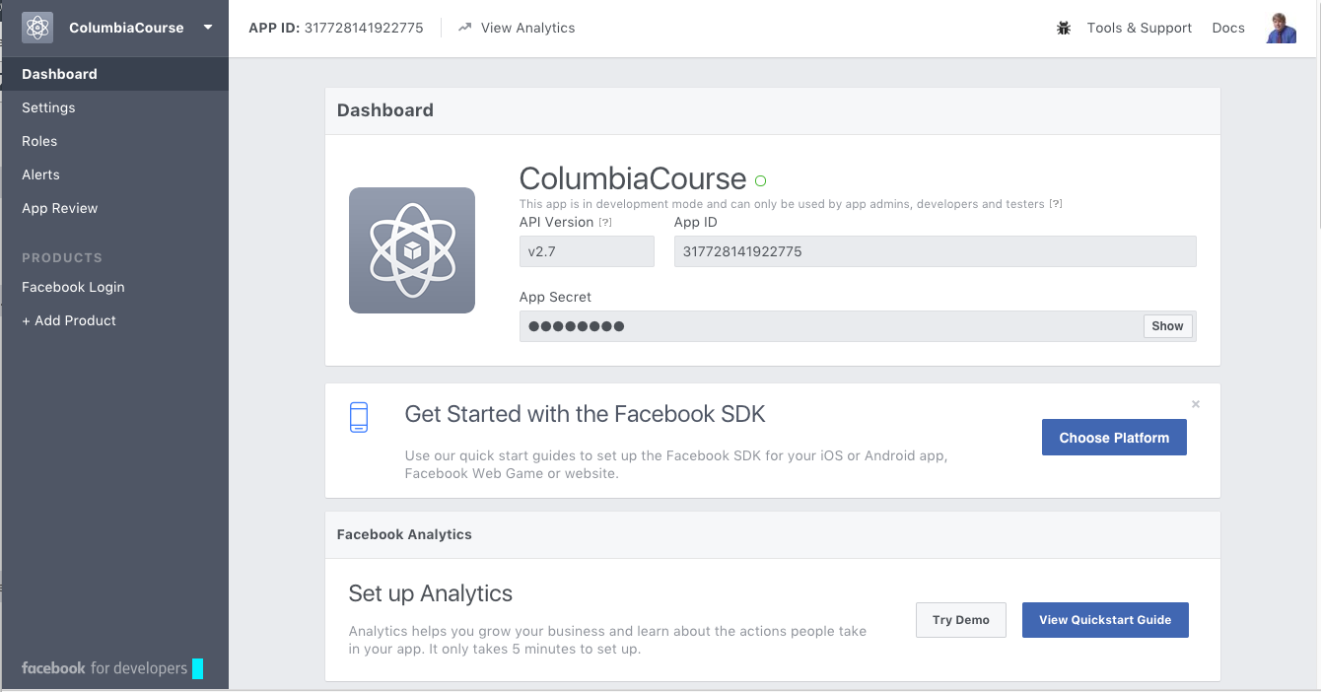
Facebook Applications
Facebook Application
Define an application at developers.facebook.com/apps/
Users log into your application via Facebook.
This grants your application permission to access the user’s Facebook content.
User must approve access on login and Facebook must “approve” the application for non-profile information.
Once logged onto your application via Facebook, you can
Get basic information about people.
Enable people to share, etc. information from your application to Facebook.
Perform analytics on users and their networks, subject to granted permissions.

Slide 40
Approaches to creating a “primary key.”
UUID

Slide 41
MATCH (n {uni: "al1"})-[r:FOLLOWS *0..4]->(q) return n,r,q
match (n:Fan)-[r:FOLLOWS]->(p)-[r2:SUPPORTS]->(t) return n,r,p,r2,t
match (n:Fan {uni: 'al1'})-[r:FOLLOWS]->(p)-[r2:SUPPORTS]->(t) return n,r,p,r2,t
match (n:Fan {uni: 'al1'})-[r:FOLLOWS *0..2]->(p)-[r2:SUPPORTS]->(t) return n,r,p,r2,t
create (p:Faculty {uni: 'dff9', name_last: "Ferguson", name_first: "Donald"}) return p

Slide 42
Graph Database Summary
42 | Introduction to Databases (F18): Lecture 13 -- NoSQL, Normalization

Slide 43
Graph Databases
Popularity and usage has exploded in the past few years.
Facebook Graph API (https://developers.facebook.com/docs/graph-api/)
LinkedIn (https://developer.linkedin.com/docs/rest-api)
Instagram (https://developers.facebook.com/docs/instagram-api)
Google Knowledge Graph (https://developers.google.com/knowledge-graph/)
Two major motivations:
Many common types of data are inherently graph oriented, and representing in RDB or some other mechanism results in icky code.
Performs of common graph operations is extremely slow in RDB.

Slide 44
Redis
44 | Introduction to Databases (F18): Lecture 13 -- No SQL, Normalization

Slide 45



Redis
Redis Key-Value Database:
Practical Introduction
SoftUni Team
Technical Trainers
Software University
http://softuni.bg

Slide 46

Redis
Ultra-Fast Data Structure Server

Slide 47

What is Redis?
Redis is:
Ultra-fast in-memory key-value data store
Powerful data structure server
Open-source software: http://redis.io
Redis stores data structures:
Strings, lists, hashes, sets, sorted sets
Publish / subscribe messaging

Slide 48

Redis: Features
Redis is really fast
Non-blocking I/O, single threaded
100,000+ read / writes per second
Redis is not a database
It complements your existing data storage layer
E.g. StackOverflow uses Redis for data caching
For small labs Redis may replace entirely the database
Trade performance for durability → data is persisted immediately

Slide 49
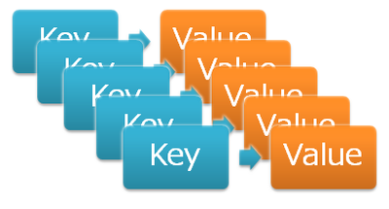
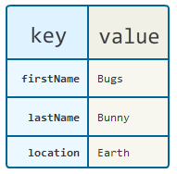
Redis: Data Model
Redis keeps key-value pairs
Every item is stored as key + value
Keys are unique identifiers
Values can be different data structures:
Strings (numbers are stored as strings)
Lists (of strings)
Hash tables: string → string
Sets / sorted sets (of strings)

Slide 50
Redis: Commands
Redis works as interpreter of commands:
SET name "Nakov"
OK
GET name
"Nakov"
DEL name
(integer) 1
GET name
(nil)
Play with the command-line client redis-cli
Or play with Redis online at http://try.redis.io

Slide 51
String Commands
SET [key] [value]
Assigns a string value in a key
GET [key] / MGET [keys]
Returns the value by key / keys
INCR [key] / DECR [key]
Increments / decrements a key
STRLEN [key]
Returns the length of a string
SET name "hi"
OK
GET name
"hi"
SET name abc
OK
GET "name"
"abc"
GET Name
(nil)
SET a 1234
OK
INCR a
(integer) 1235
GET a
"12345"
MGET a name
1) "1235"
2) "asdda"
STRLEN a
(integer) 4

Slide 52
Working with Keys
EXISTS [key]
Checks whether a key exists
TYPE [key]
Returns the type of a key
DEL [key]
Deletes a key
EXPIRE [key] [t]
Deletes a key after t seconds
SET count 5
OK
TYPE count
string
EXISTS count
(integer) 1
DEL count
(integer) 1
EXISTS count
(integer) 0
SET a 1234
OK
GET a
"1234"
EXPIRE a 5
(integer) 1
EXISTS a
(integer) 1
EXISTS a
(integer) 0

Slide 53
Working with Hashes (Hash Tables)
HSET [key] [field] [value]
Assigns a value for given field
HKEYS [key]
Returns the fields (keys) is in a hash
HGET [key] [field]
Returns a value by fields from a hash
HDEL [key] [field]
Deletes a fields from a hash
HSET user name "peter"
(integer) 1
HSET user age 23
(integer) 1
HKEYS user
1) "name"
2) "age"
HGET user age
"23"
HDEL user age
(integer) 1

Slide 54
Working with Lists
RPUSH / LPUSH [list] [value]
Appends / prepend an value to a list
LINDEX [list] [index]
Returns a value given index in a list
LLEN [list]
Returns the length of a list
LRANGE [list] [start] [count]
Returns a sub-list (range of values)
RPUSH names "peter"
(integer) 1
LPUSH names Nakov
(integer) 1
LINDEX names 0
"Nakov"
LLEN names
(integer) 2
LRANGE names 0 100
1) "Nakov"
2) "peter"

Slide 55
Working with Sets
SADD [set] [value]
Appends a value to a set
SMEMBERS [set]
Returns the values from a set
SREM [set] [value]
Deletes a value form a set
SCARD [set]
Returns the stack size (items count)
SADD users "peter"
(integer) 1
SADD users "peter"
(integer) 0
SADD users maria
(integer) 1
SMEMBERS users
1) "peter"
2) "maria"
SREM users maria
(integer) 1

Slide 56
Working with Sorted Sets
ZADD myzset 1 "one"
(integer) 1
ZADD myzset 1 "uno"
(integer) 1
ZADD myzset 2 "two" 3 "three"
(integer) 2
ZRANGE myzset 0 -1 WITHSCORES
1) "one"
2) "1"
…
Learn more at http://redis.io/commands#sorted_set

Slide 57
Publish / Subscribe Commands
First user subscribes to certain channel "news"
Another user sends messages to the same channel "news"
Learn more at http://redis.io/commands#pubsub
SUBSCRIBE news
1) "subscribe"
2) "news"
3) (integer) 1
PUBLISH news "hello"
(integer) 1

Slide 58
Using Redis as a Database
Special naming can help using Redis as database
Add a user "peter".
SADD users:names peter
HSET users:peter name "Peter Petrov"
HSET users:peter email "pp@gmail.com"
SADD users:names maria
HSET users:maria name "Maria Ivanova"
HSET users:maria email "maria@yahoo.com"
SMEMBERS users:names
HGETALL users:peter
Use "users:peter" as key to hold user data
Add a user "maria".
List all users
List all properties for user "peter"

Slide 59


Summary
Redis is ultra-fast in-memory data store
Not a database, used along with databases
Supports strings, numbers, lists, hashes, sets, sorted sets, publish / subscribe messaging
Used for caching / simple apps
Databases

Slide 60
DynamoDB
60 | Introduction to Databases (F18): Lecture 13 -- No SQL, Normalization

Slide 61
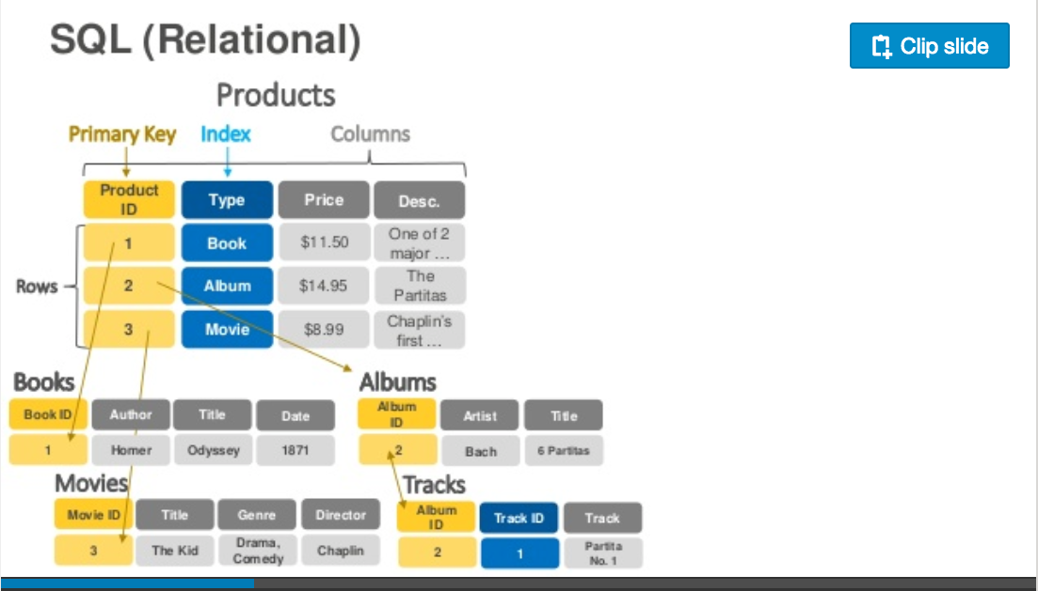
DynamoDB Data Model
https://www.slideshare.net/AmazonWebServices/introduction-to-amazon-dynamodb-73191648

Slide 62
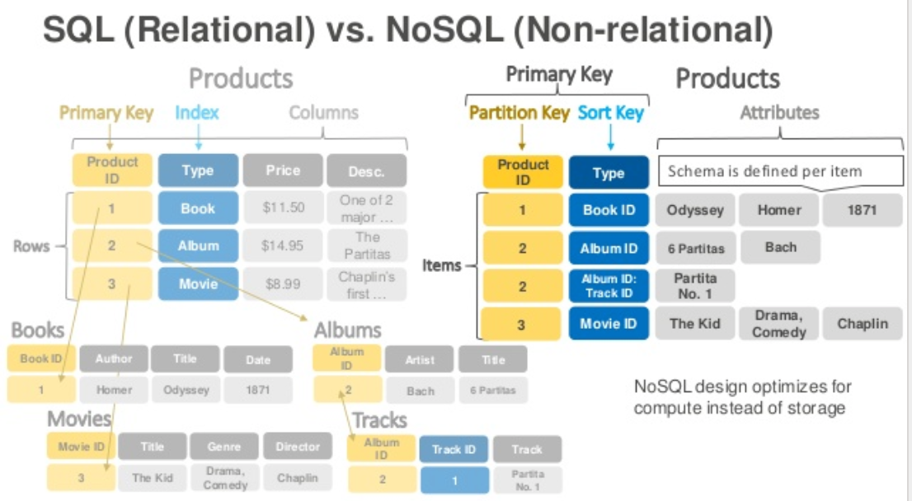
DynamoDB Data Model

Slide 63
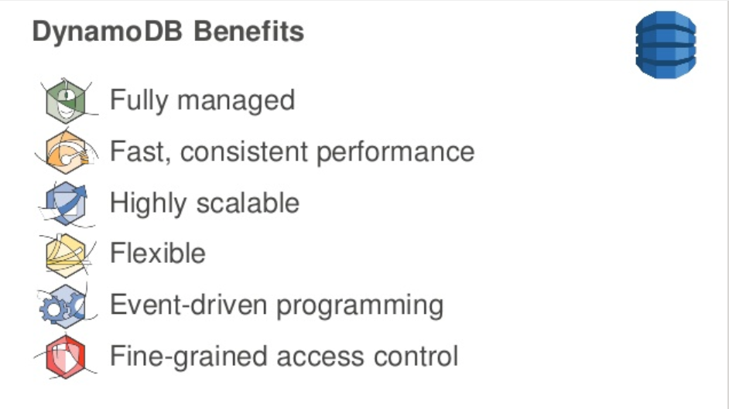
DynamoDB

Slide 64
DynamoDB Hashing

Slide 65
Approaches to Scalability

Slide 66
Share Nothing Architecture

Slide 67
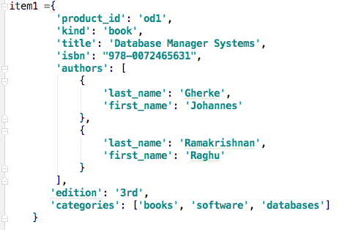
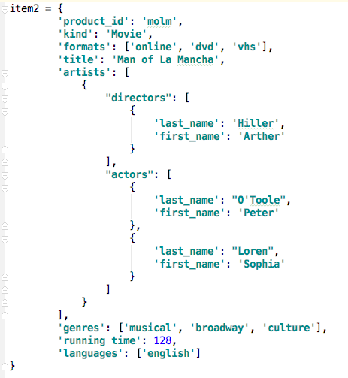
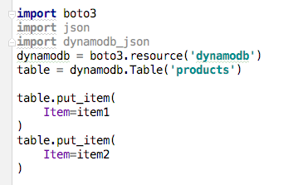
Sample Code

Slide 68
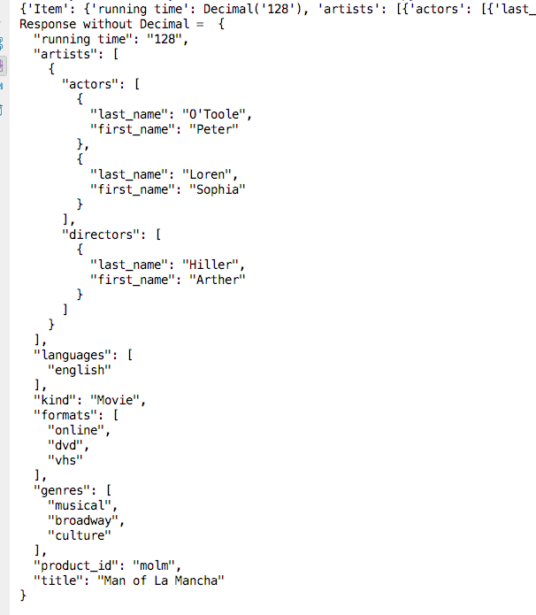
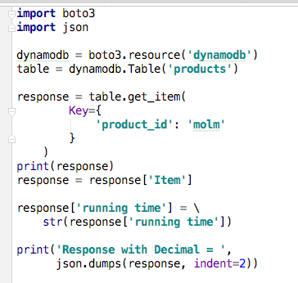
Sample Code

Slide 69
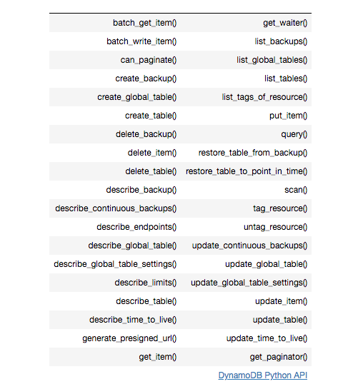
DynamoDB Summary
Achieves much greater scalability and performance than RDBMs
Does not support some RDBMs capabilities:
Referential integrity.
JOIN
Queries limited to key fields.
Non-key field queries are always scans.
Data model better fit for semi-structured data models and good fit for JSON
Maps
Lists

Slide 70
Putting the Pieces Together, if we had time.
70 | Introduction to Databases (F18): Lecture 13 -- No SQL, Normalization

Slide 71
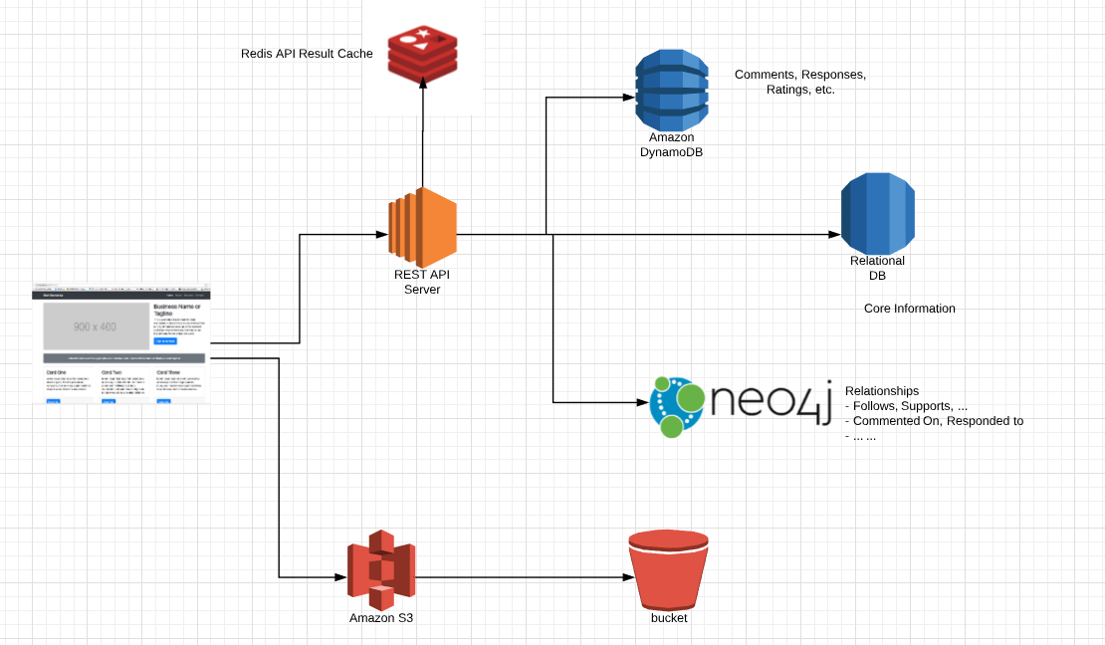
Putting the Pieces Together (If we had time)

Slide 72
Normalization/De-normalization
72 | Introduction to Databases (F18): Lecture 13 -- No SQL, Normalization

Slide 73
Schema Refinement and Normal Forms
Chapter 19
Note:
There is a theoretical/formal basis for normalization in the relational model.
Has practical application to real scenarios and data models.
Primarily applied intuitively and based on common sense, not theory.
But, like relational algebra, I have to give you an overview of the theory.
Notes:
1
The slides for this text are organized into chapters. This lecture covers Chapter 19, on formal, dependency-driven database design..
Integrity constraints, in particular functional dependencies, play an important role in the design of database schemas. In particular, they can shed light on potential redundancies (and the problems that go with redundancy) in a relational schema. Typically, they are used to analyze the relational schema obtained by converting an ER diagram.
This chapter can be covered any time after the Foundations material (Chapters 1 to 5) is covered, at the instructor’s discretion. A good choice is to cover it after presenting all the implementation related material that is included in a course. This will allow a design sequence consisting of Chapters 19 and 20, and will enable the instructor to bring out the fact that design involves both redundancy analysis and performance considerations, and that these concerns should go hand-in-hand.

Slide 74
The Evils of Redundancy
Redundancy is at the root of several problems associated with relational schemas:
redundant storage, insert/delete/update anomalies
Integrity constraints, in particular functional dependencies, can be used to identify schemas with such problems and to suggest refinements.
Main refinement technique: decomposition (replacing ABCD with, say, AB and BCD, or ACD and ABD).
Decomposition should be used judiciously:
Is there reason to decompose a relation?
What problems (if any) does the decomposition cause?
Notes:
14

Slide 75
Functional Dependencies (FDs)
A functional dependency X Y holds over relation R if, for every allowable instance r of R:
t1 r, t2 r, (t1) = (t2) implies (t1) = (t2)
i.e., given two tuples in r, if the X values agree, then the Y values must also agree. (X and Y are sets of attributes.)
An FD is a statement about all allowable relations.
Must be identified based on semantics of application.
Given some allowable instance r1 of R, we can check if it violates some FD f, but we cannot tell if f holds over R!
K is a candidate key for R means that K R
However, K R does not require K to be minimal!
Notes:
15

Slide 76
Example: Constraints on Entity Set
Consider relation obtained from Hourly_Emps:
Hourly_Emps (ssn, name, lot, rating, hrly_wages, hrs_worked)
Notation: We will denote this relation schema by listing the attributes: SNLRWH
This is really the set of attributes {S,N,L,R,W,H}.
Sometimes, we will refer to all attributes of a relation by using the relation name. (e.g., Hourly_Emps for SNLRWH)
Some FDs on Hourly_Emps:
ssn is the key: S SNLRWH
rating determines hrly_wages: R W
Notes:
16

Slide 77
Example (Contd.)
Wages
Hourly_Emps2
Problems due to R W :
Update anomaly: Can we change W in just the 1st tuple of SNLRWH?
Insertion anomaly: What if we want to insert an employee and don’t know the hourly wage for his rating?
Deletion anomaly: If we delete all employees with rating 5, we lose the information about the wage for rating 5!
Will 2 smaller tables be better?
Notes:
17

Slide 78
Example: Constraints on Entity Set
Consider relation obtained from Hourly_Emps:
Hourly_Emps (ssn, name, lot, rating, hrly_wages, hrs_worked)
Notation: We will denote this relation schema by listing the attributes: SNLRWH
This is really the set of attributes {S,N,L,R,W,H}.
Sometimes, we will refer to all attributes of a relation by using the relation name. (e.g., Hourly_Emps for SNLRWH)
Some FDs on Hourly_Emps:
ssn is the key: S SNLRWH
rating determines hrly_wages: R W
A more intuitive example – Consider a table of addresses.
Addresses(id, street_no, street_name, city, country, zipcode)
(city, country) are functionally dependent on zipcode.
Notes:
16

Slide 79
Reasoning About FDs
Given some FDs, we can usually infer additional FDs:
ssn did, did lot implies ssn lot
An FD f is implied by a set of FDs F if f holds whenever all FDs in F hold.
= closure of F is the set of all FDs that are implied by F.
Armstrong’s Axioms (X, Y, Z are sets of attributes):
Reflexivity: If X Y, then Y X
Augmentation: If X Y, then XZ YZ for any Z
Transitivity: If X Y and Y Z, then X Z
These are sound and complete inference rules for FDs!
Notes:
19

Slide 80
Normal Forms
Returning to the issue of schema refinement, the first question to ask is whether any refinement is needed!
If a relation is in a certain normal form (BCNF, 3NF etc.), it is known that certain kinds of problems are avoided/minimized. This can be used to help us decide whether decomposing the relation will help.
Role of FDs in detecting redundancy:
Consider a relation R with 3 attributes, ABC.
No FDs hold: There is no redundancy here.
Given A B: Several tuples could have the same A value, and if so, they’ll all have the same B value!
Notes:
22

Slide 81
Boyce-Codd Normal Form (BCNF)
Reln R with FDs F is in BCNF if, for all X A in
A X (called a trivial FD), or
X contains a key for R.
In other words, R is in BCNF if the only non-trivial FDs that hold over R are key constraints.
No dependency in R that can be predicted using FDs alone.
If we are shown two tuples that agree upon the X value, we cannot infer the A value in one tuple from the A value in the other.
If example relation is in BCNF, the 2 tuples must be identical (since X is a key).
Notes:
23

Slide 82
Third Normal Form (3NF)
Reln R with FDs F is in 3NF if, for all X A in
A X (called a trivial FD), or
X contains a key for R, or
A is part of some key for R.
Minimality of a key is crucial in third condition above!
If R is in BCNF, obviously in 3NF.
If R is in 3NF, some redundancy is possible. It is a compromise, used when BCNF not achievable (e.g., no ``good’’ decomp, or performance considerations).
Lossless-join, dependency-preserving decomposition of R into a collection of 3NF relations always possible.
Notes:
24

Slide 83
Example Decomposition
Decompositions should be used only when needed.
SNLRWH has FDs S SNLRWH and R W
Second FD causes violation of 3NF; W values repeatedly associated with R values. Easiest way to fix this is to create a relation RW to store these associations, and to remove W from the main schema:
i.e., we decompose SNLRWH into SNLRH and RW
The information to be stored consists of SNLRWH tuples. If we just store the projections of these tuples onto SNLRH and RW, are there any potential problems that we should be aware of?
Notes:
27

Slide 84
Problems with Decompositions
There are three potential problems to consider:
Some queries become more expensive.
e.g., How much did sailor Joe earn? (salary = W*H)
Given instances of the decomposed relations, we may not be able to reconstruct the corresponding instance of the original relation!
Fortunately, not in the SNLRWH example.
Checking some dependencies may require joining the instances of the decomposed relations.
Fortunately, not in the SNLRWH example.
Tradeoff: Must consider these issues vs. redundancy.
Notes:
28

Slide 85
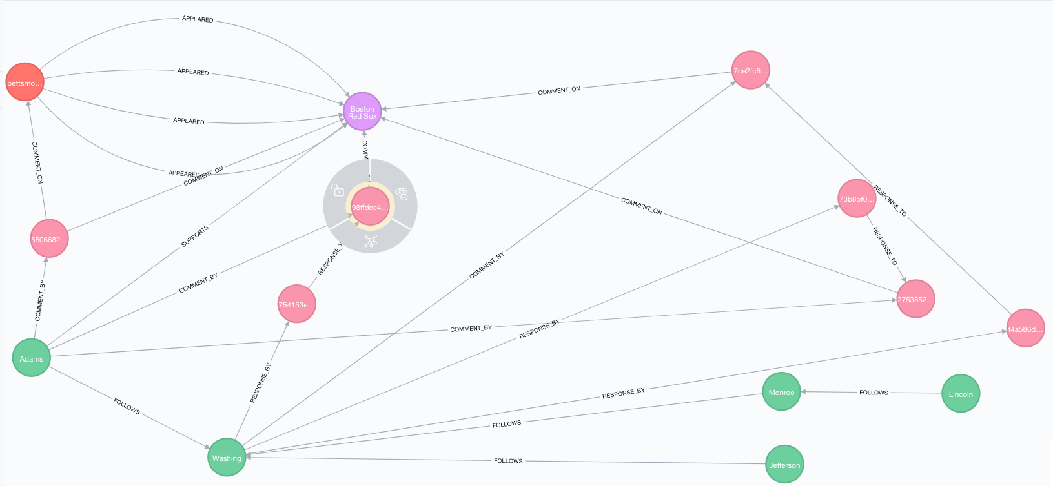
Three relationships created.

